Slide 1
Sunset Vacation
ERD and Class Diagram
A2 Group 2
1605051
1705040
1705042
1705043
1705048
1705060

Slide 2
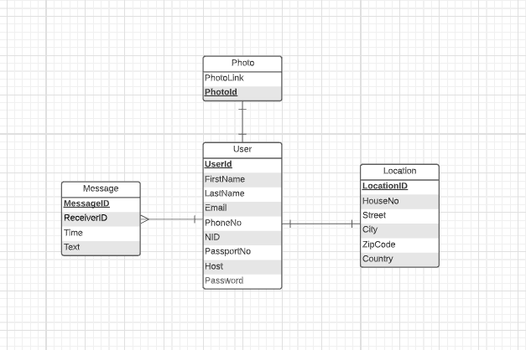
User Entity
Overview

Slide 3
User
Users will create their accounts using necessary information
Notes:
Users will create their accounts using necessary information

Slide 4
User
Photos will be saved in database as links instead of byte arrays to save space
Notes:
Users will create their accounts using necessary information

Slide 5
User
User’s current location will be saved during sign up
Notes:
Users will create their accounts using necessary information

Slide 6
User
A chat system will be available to the users
Notes:
Users will create their accounts using necessary information

Slide 7
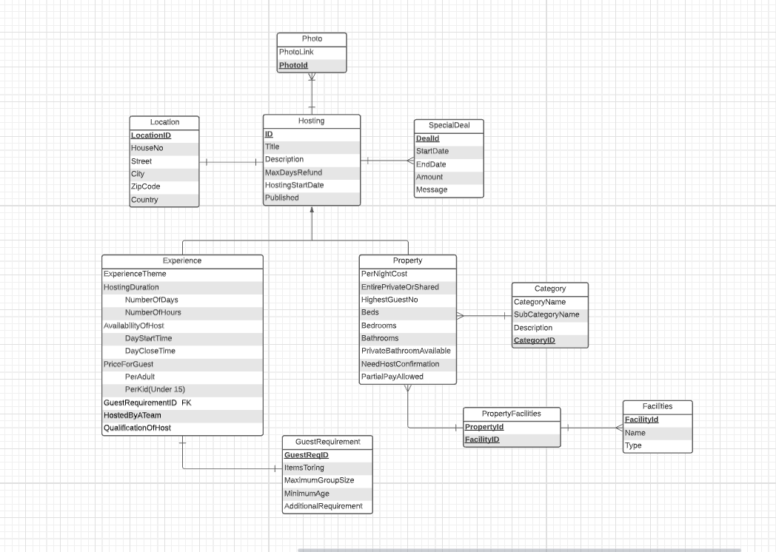
Hosting Overview

Slide 8
Hosting
Hosting entity consists of the information that are common to the two entities that inherited it, ‘Experience’ and ‘Property’
Notes:
Hosting entity consists of the information that are common to the two entities that inherited it, ‘Experience’ and ‘Property’

Slide 9
Hosting
Location table consists of the attributes where the hosting is being done

Slide 10
Hosting
As usual, any photos associated with the advertisements of a hosting plan will be saved as links in database.

Slide 11
Hosting
Host can offer discounts based on bookings on specific time intervals

Slide 12
Hosting
There are two types of hosting:
Experience
Property

Slide 13
Hosting
Experience hosting includes providing tour guides for a specific amount of time to tour any type of place like zoos, music theatres, museums etc.
Information like pricing to guide adults or children, start and end time of tours are also included
Notes:
Information like pricing to guide adults or children, start and end time of tours are also included

Slide 14
Hosting
Some tours might also require extra items or information such as trekking shoes (for hiking mountains), extra people to assist the tourists and count of total people in group etc.
Notes:
Some tours might also require extra items such as sticks (for hiking mountains), extra people

Slide 15
Hosting
Property hosting includes hosting physical properties.
All necessary information and specifications of the rooms and facilities are stored in this table
Notes:
All necessary information regarding the hotel rooms are stored in this table

Slide 16
Hosting
These types of physical properties are categorized (such as apartments, cottages, flats etc) and the categories and subcategories are stored in this table
Notes:
All necessary information regarding the hotel rooms are stored in this table

Slide 17
Hosting
Some properties provide special facilities like
Safety attributes
Fire alarms
First aid kits
Guest favorites
Wifi
Mountain view
Pools
Balconies
Notes:
All necessary information regarding the hotel rooms are stored in this table

Slide 18
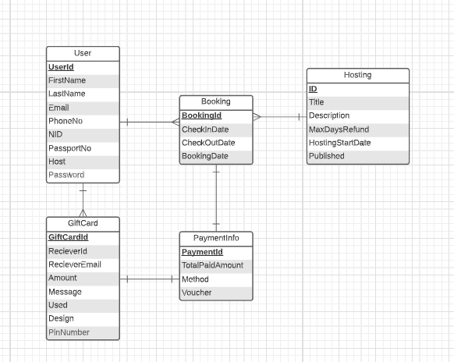
Booking Overview
Notes:
A booking of a user will contain the associated checkin and checkout dates

Slide 19
Booking
A booking of a user will contain the associated checkin and checkout dates
Notes:
A booking of a user will contain the associated checkin and checkout dates

Slide 20
Booking
Gift cards can reduce the amount payable for a customer
Notes:
A booking of a user will contain the associated checkin and checkout dates

Slide 21
Booking
Users can pay through cash/ card/ fintech facilities like paypal
Notes:
A booking of a user will contain the associated checkin and checkout dates

Slide 22
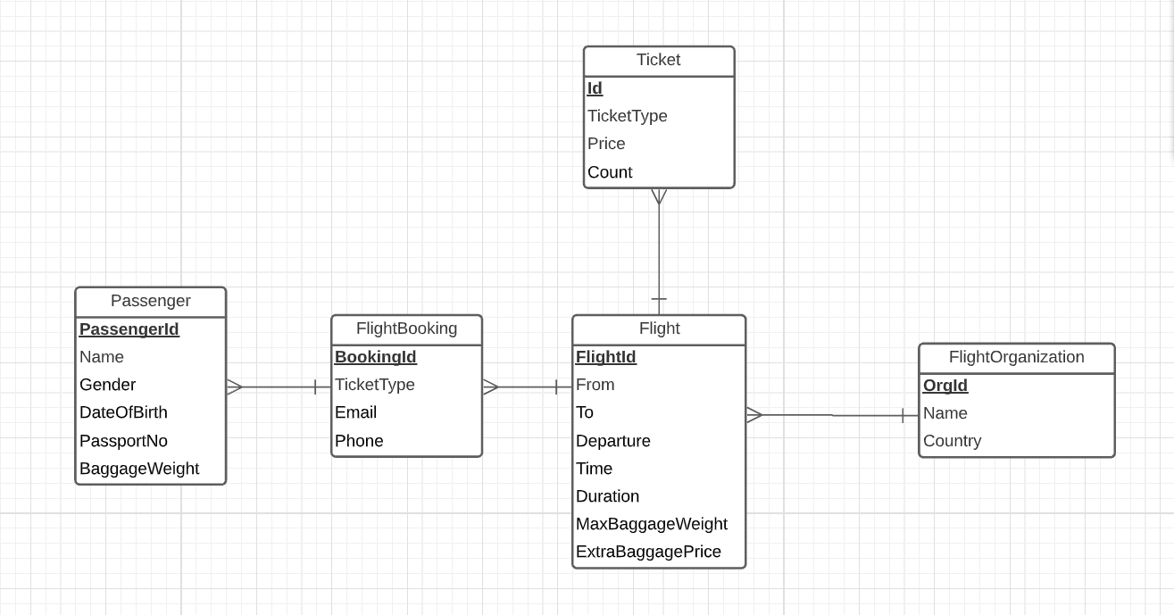
Flight Overview

Slide 23
Flight
A primary passenger can book tickets on behalf of all the members of his/her group. Information of each passenger is stored here
Notes:
A customer can book tickets on behalf of all the members of his/her group.

Slide 24
Flight
The primary passenger can book a flight on behalf of all the passengers with necessary info like ticket type (premium, economy, business) and the primary passenger’’s contact info
Notes:
A customer can book tickets on behalf of all the members of his/her group.

Slide 25
Flight
A flight includes the from and to locations, times and baggage pricings
Notes:
A customer can book tickets on behalf of all the members of his/her group.

Slide 26
Flight
A flight is conducted by a flight organization company (e.g. Bangladesh Biman)
Notes:
A customer can book tickets on behalf of all the members of his/her group.

Slide 27
Flight
The available types of tickets and their pricings for a specific flight is stored in this entity
Notes:
A customer can book tickets on behalf of all the members of his/her group.

Slide 28
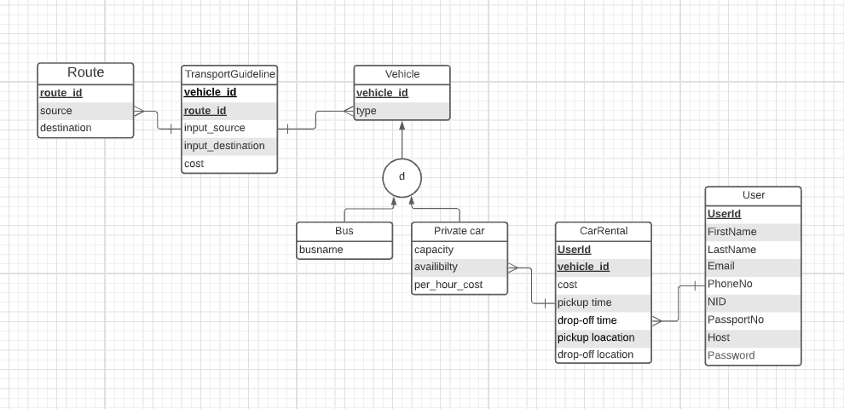
Transport Overview

Slide 29
Transport
A user can rent a car by specifying times, locations and cost
Notes:
A user can rent a car by specifying times, locations and cost

Slide 30
Transport
There are many types of vehicles like Bus, Private Cars
Notes:
A user can rent a car by specifying times, locations and cost

Slide 31
Transport
The list of available routes for transportation will be shown to the user from the database
Notes:
A user can rent a car by specifying times, locations and cost

Slide 32
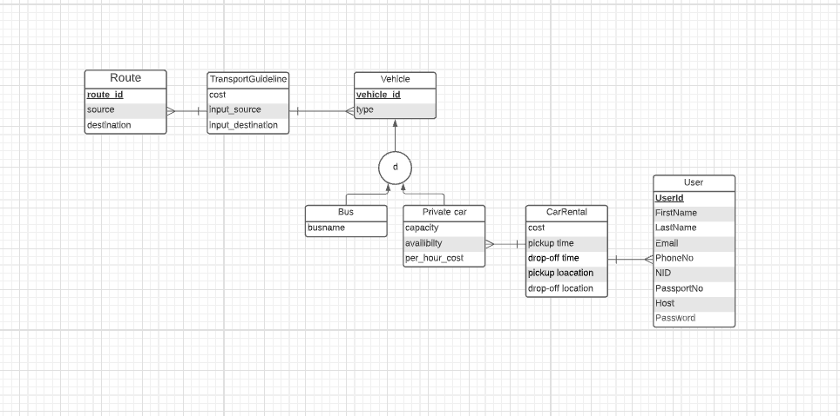
Transport
A user can select a route and get the cost estimation
Notes:
A user can rent a car by specifying times, locations and cost

Slide 33
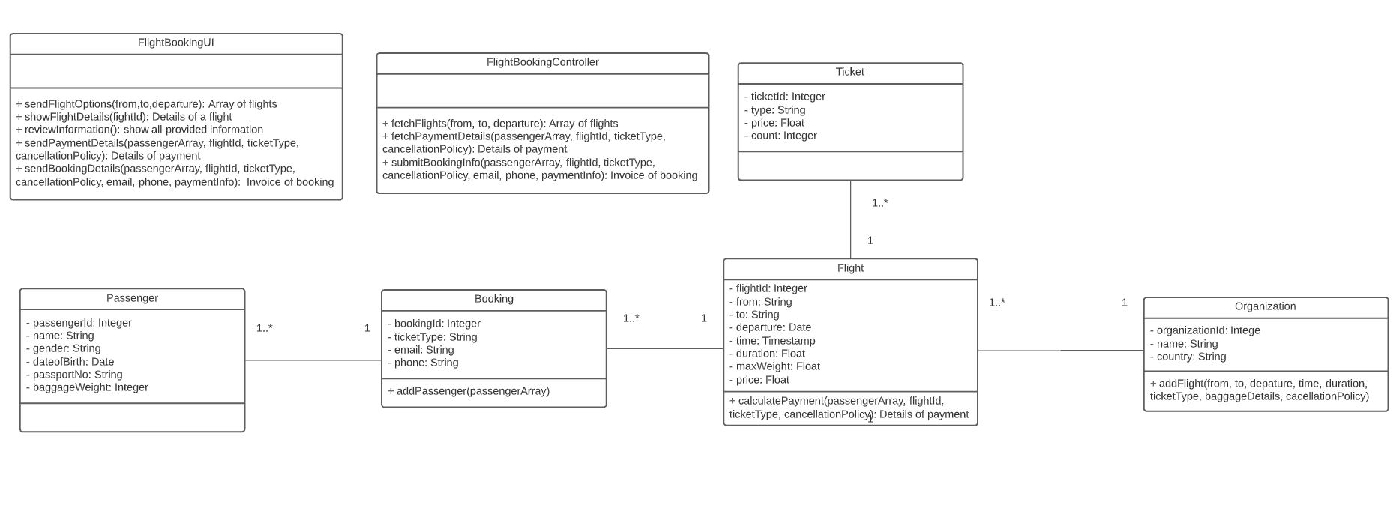
Flight Booking

Slide 34
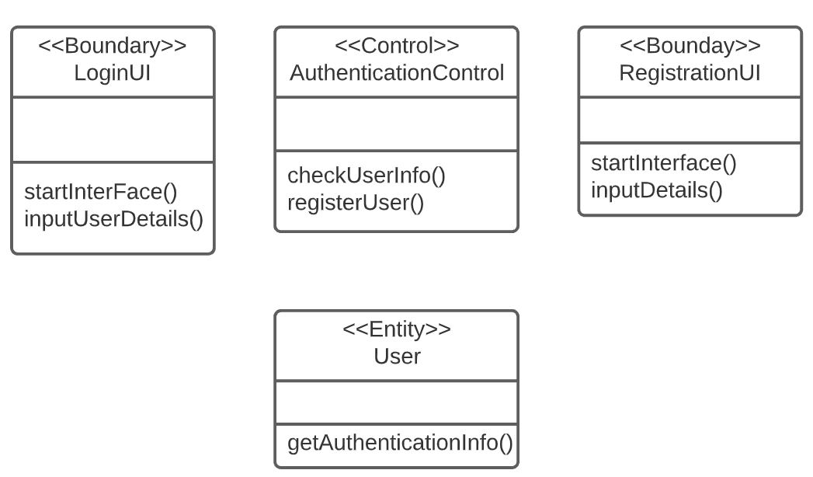
Login/Register

Slide 35
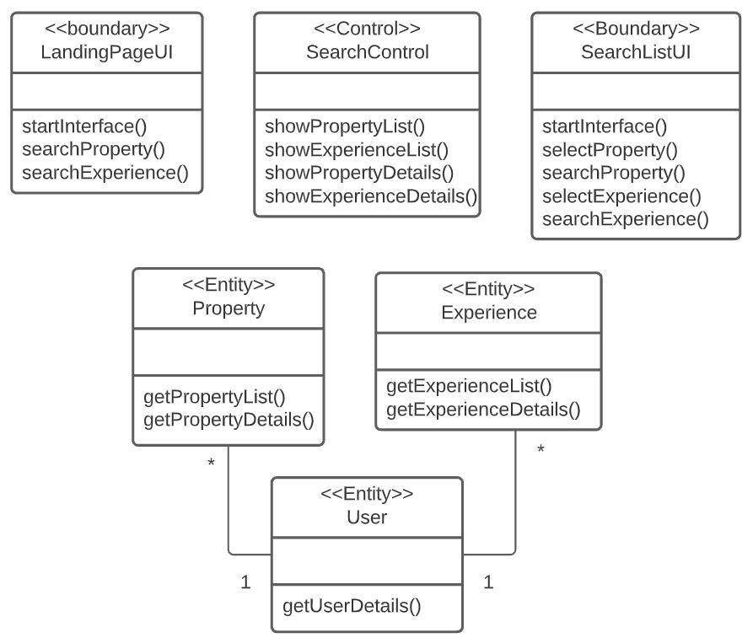
Search System

Slide 36
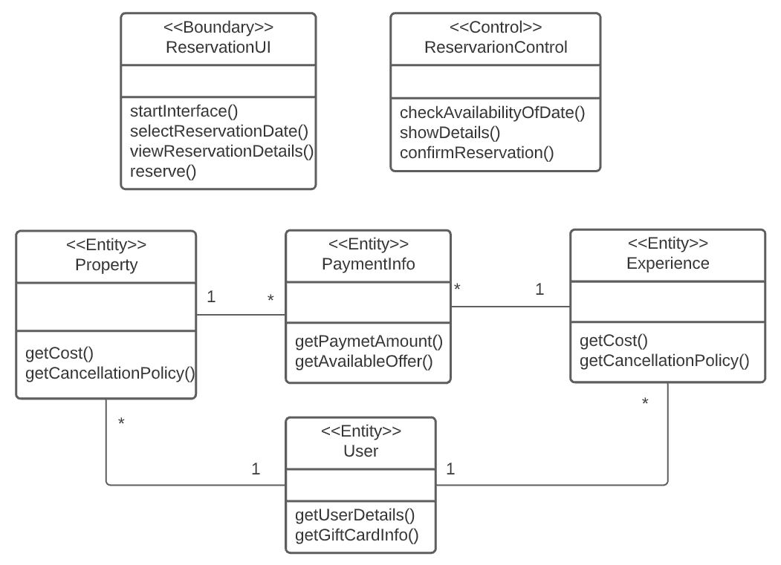
Reservation

Slide 37
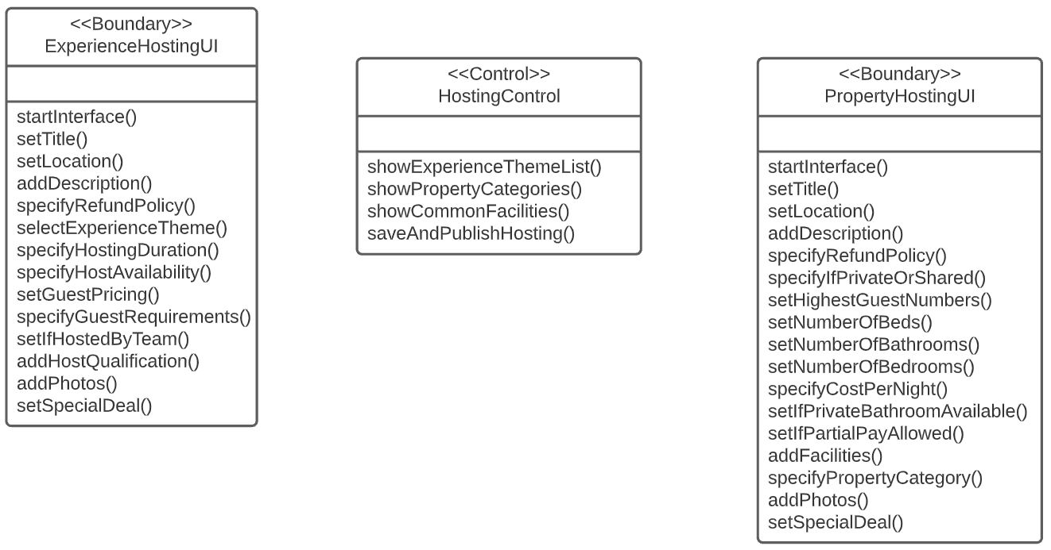
Hosting

Slide 38
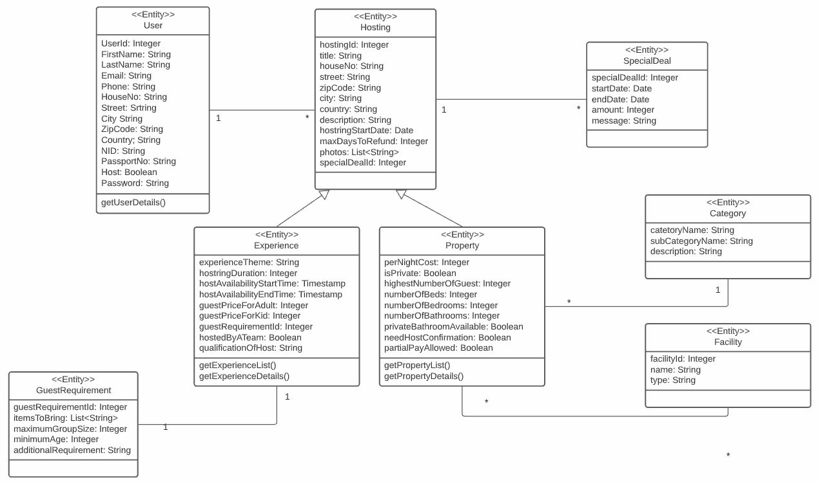

Slide 39
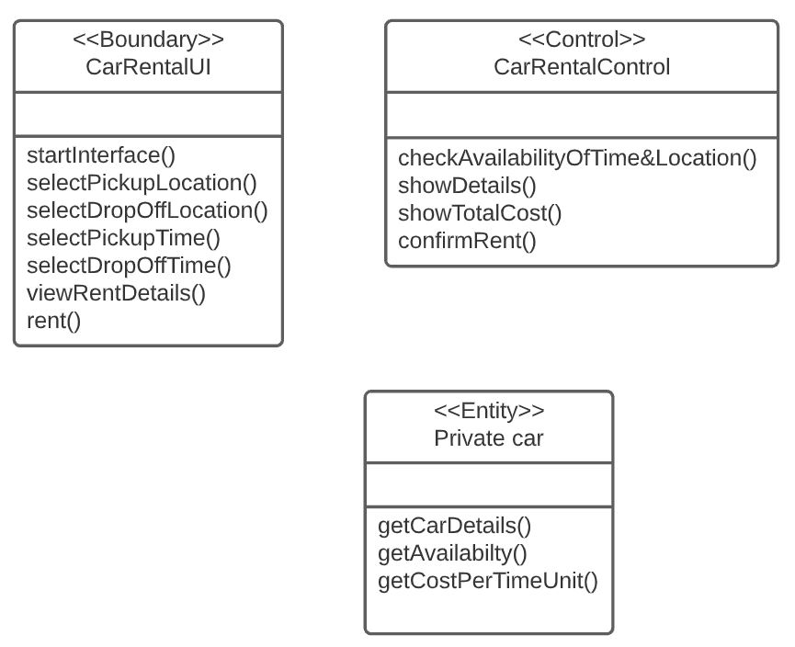
Car Rental

Slide 40
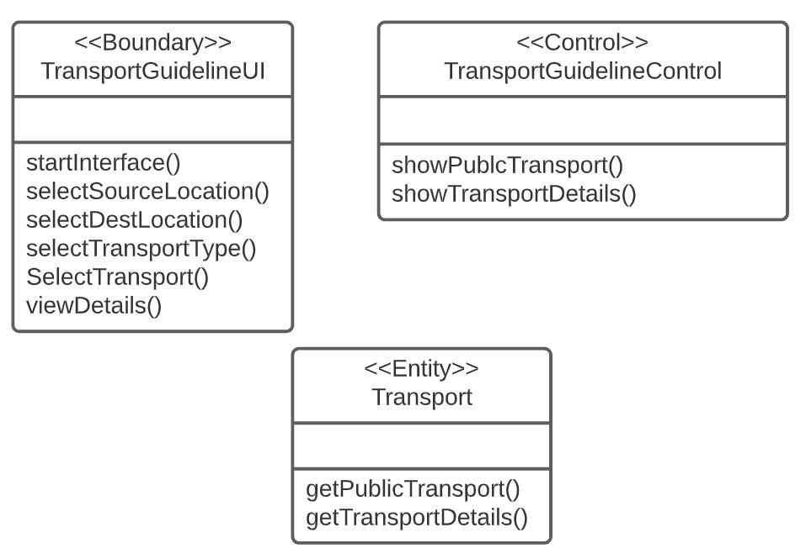
Transport Guideline

Slide 41
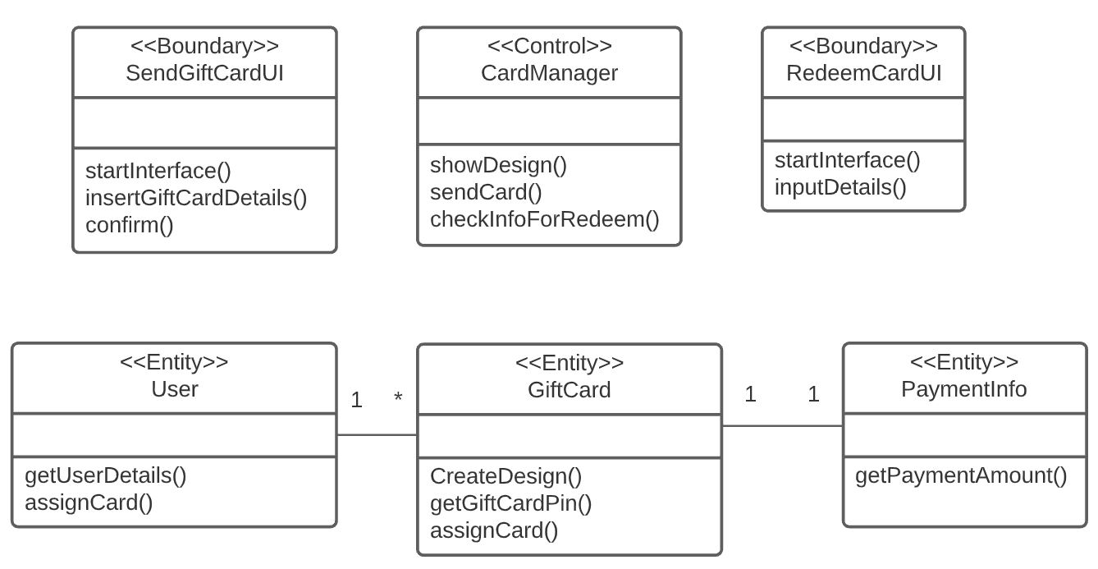
GiftCard

